Slide 1
Using an existing metabolic model to (start to) build a new one!
Dr Sandy Macdonald, Bioscience Technology Facility Bioinformatician,
Friday, 19th November, 2021

Slide 2
Where to start?
Let's imagine you have an annotated genome sequence for a bacterium and want to build a flux balance analysis (FBA) model for it. Where do you start?
You could go through the genome, gene by gene, search for that gene in KEGG or MetaCyc to find what reaction it catalyses, and then add the reactions, metabolites, and genes to your model, typing out the SBML by hand. 🤪 (I did this in my postdoc in 2008)
Starting from an existing model/s and transferring as much knowledge from that model as possible to your new model would be much better!
The result is not a complete model, but a very good starting point

Slide 3
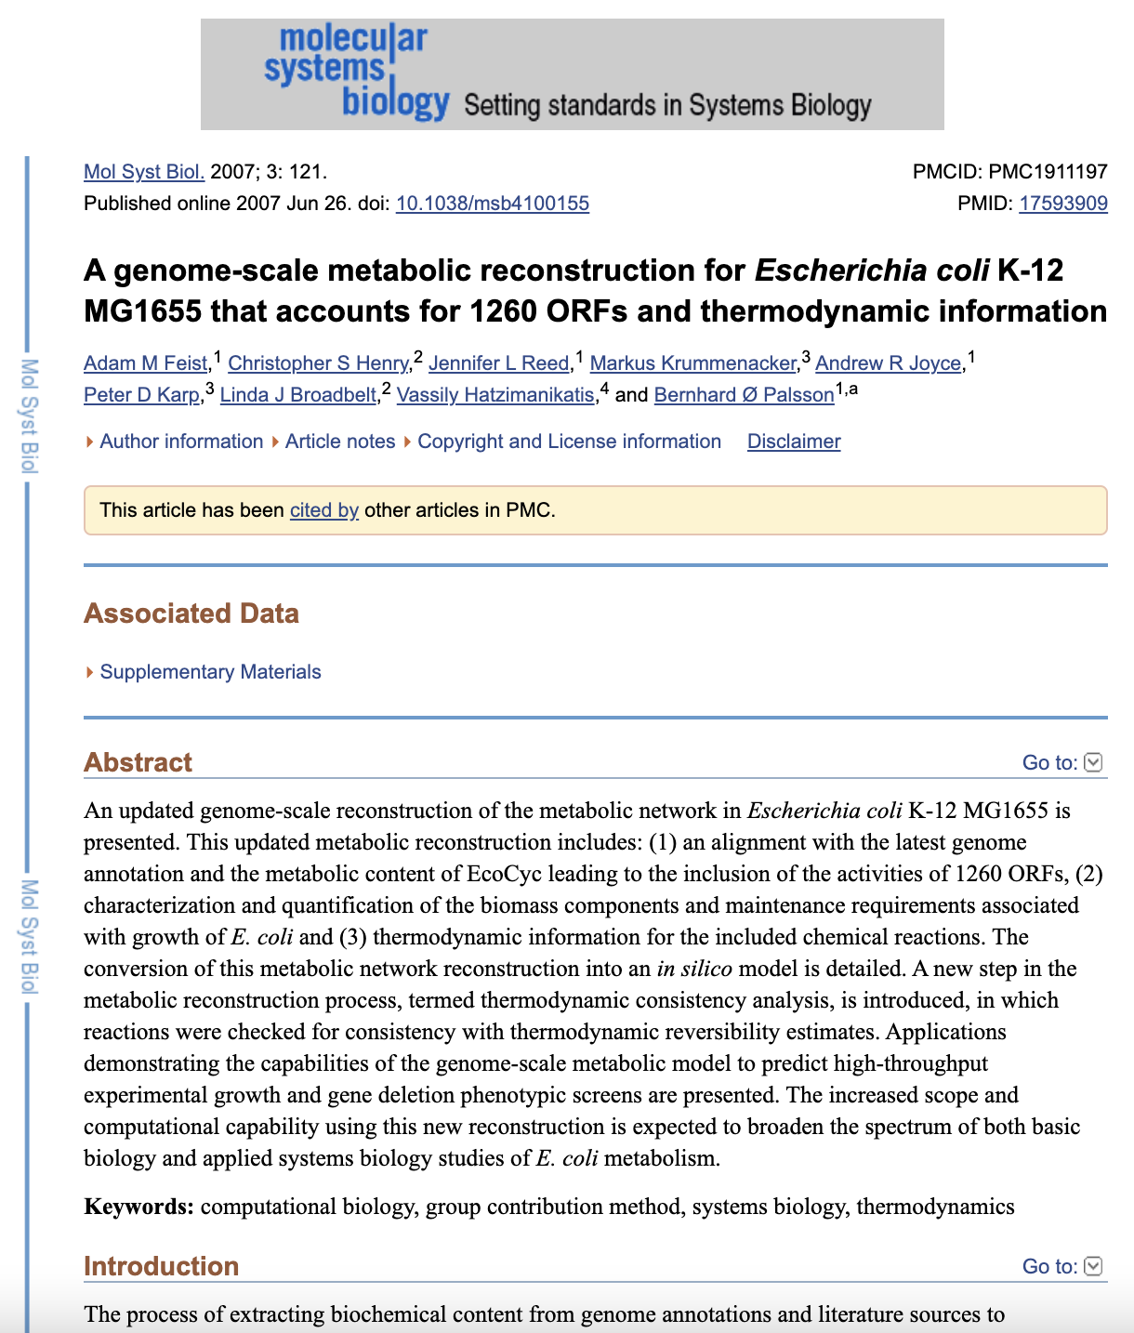
E. coli as a starting point
As with many other things, E. coli is a good starting point, because:
Its genome is very well annotated
Its metabolism is (relatively) well understood
Many of its metabolic enzymes have been studied experimentally
There have been several versions now of E. coli FBA models, each time improved and with more genes included
https://pubmed.ncbi.nlm.nih.gov/17593909/

Slide 4
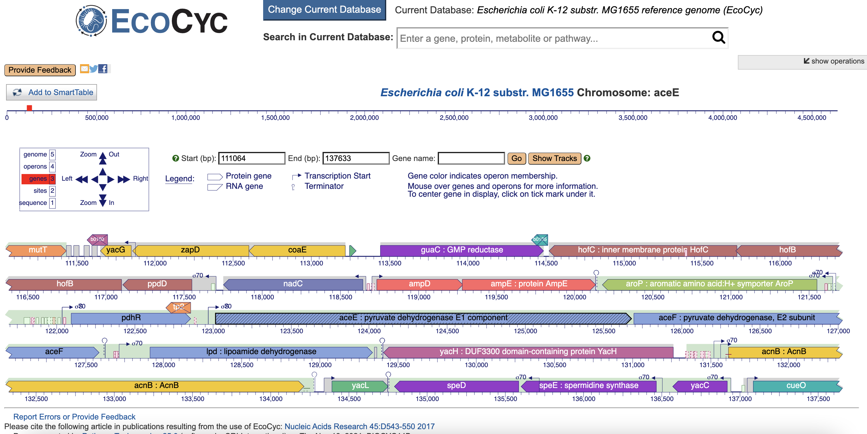
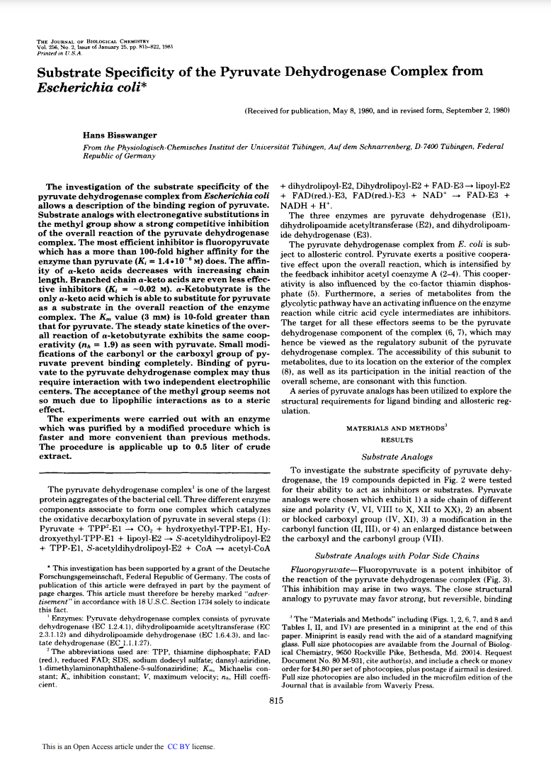
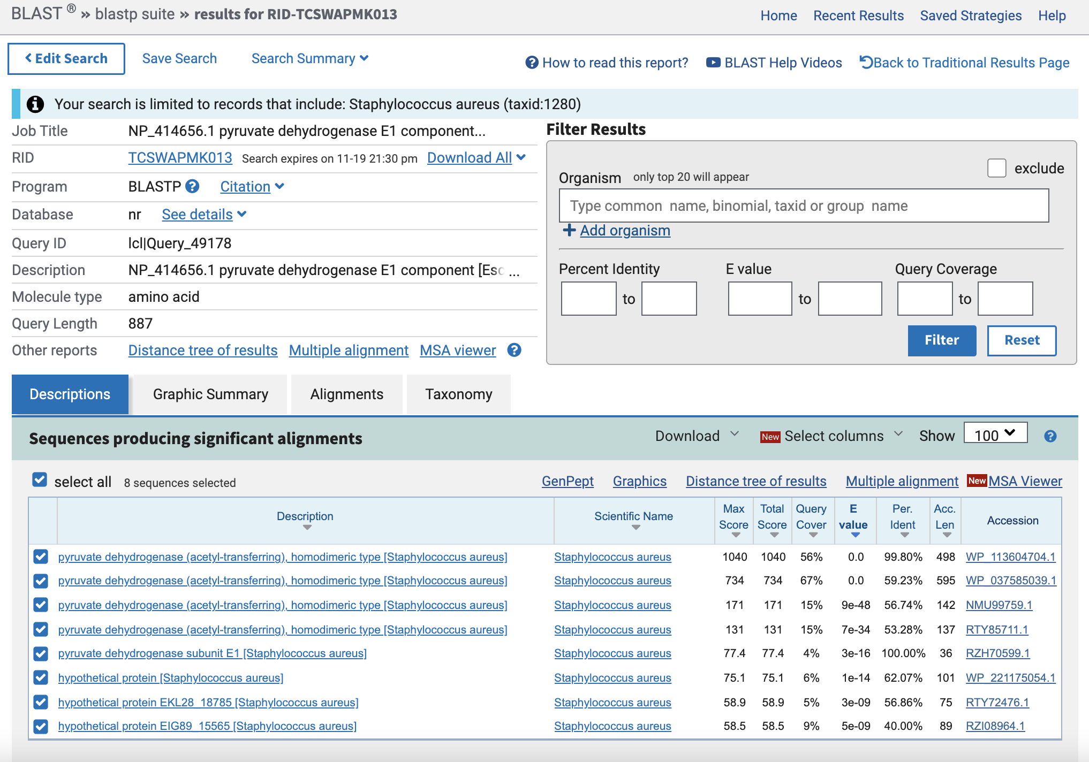
Assigning gene function
How do we know the function of a gene?
Genome sequencing, finding open reading frames (start/stop codons), and hence coding sequences for genes
Assign gene functions based on sequence similarity (homology) to other annotated genome sequences
Expressing protein, characterising it experimentally, determining protein structure
https://biocyc.org/gene?orgid=ECOLI&id=EG10024
https://blast.ncbi.nlm.nih.gov/Blast.cgi
https://www.jbc.org/article/S0021-9258(19)70050-7/pdf

Slide 5
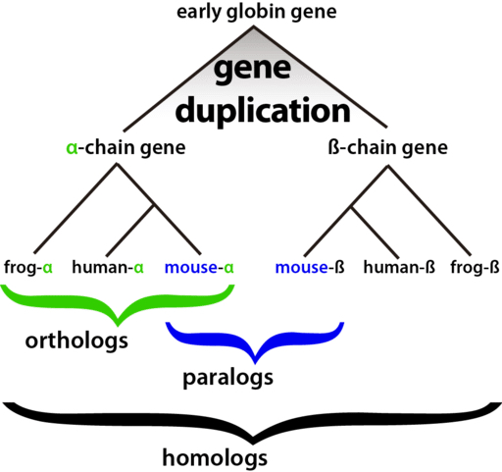
Homologs, orthologs, and paralogs
What's the difference?
"Paralogs" arise from a gene duplication event in an organism or a distant ancestor and often acquire a different function
"Orthologs" occur from a speciation event, so orthologs in two species, e.g. human and mouse α-globins, will share a function
"Homologs" can describe both paralogs and orthologs, but it's a vague term and I wouldn't encourage its use!
We're looking for orthologs
There are also analogs, xenologs, and more!
Find out more here: https://en.wikipedia.org/wiki/Sequence_homology
https://bitesizebio.com/26762/homology-terminology-never-say-wrong-word/

Slide 6
What are the pitfalls?
Is your genome similar enough to E. coli to transfer gene functions?
Use a more closely-related, well-characterised genome
Could two proteins share similar sequence but have different functions?
Yes! These could be paralogs or promiscuous enzymes
What if we match against a protein that shares a domain (part of the sequence) but has a different overall function?
We can set thresholds on our sequence searches to reduce the likelihood of this: % identity and % coverage
Finding the true ortholog is not easy!
Building a phylogenetic tree is the best way to work this out

Slide 7
Picking the right starting point
So, we need to do the following:
Pick a closely related (to our "unknown" organism), well-characterised genome, with an FBA model, as our starting point.
Carefully match gene/protein sequences from our "known" organism against our "unknown" organism's gene/protein sequences (using BLAST).
Filter down the set of reactions in the "known" FBA model to only those with matches/hits in our "unknown" organism.
And that's just the start!

Slide 8
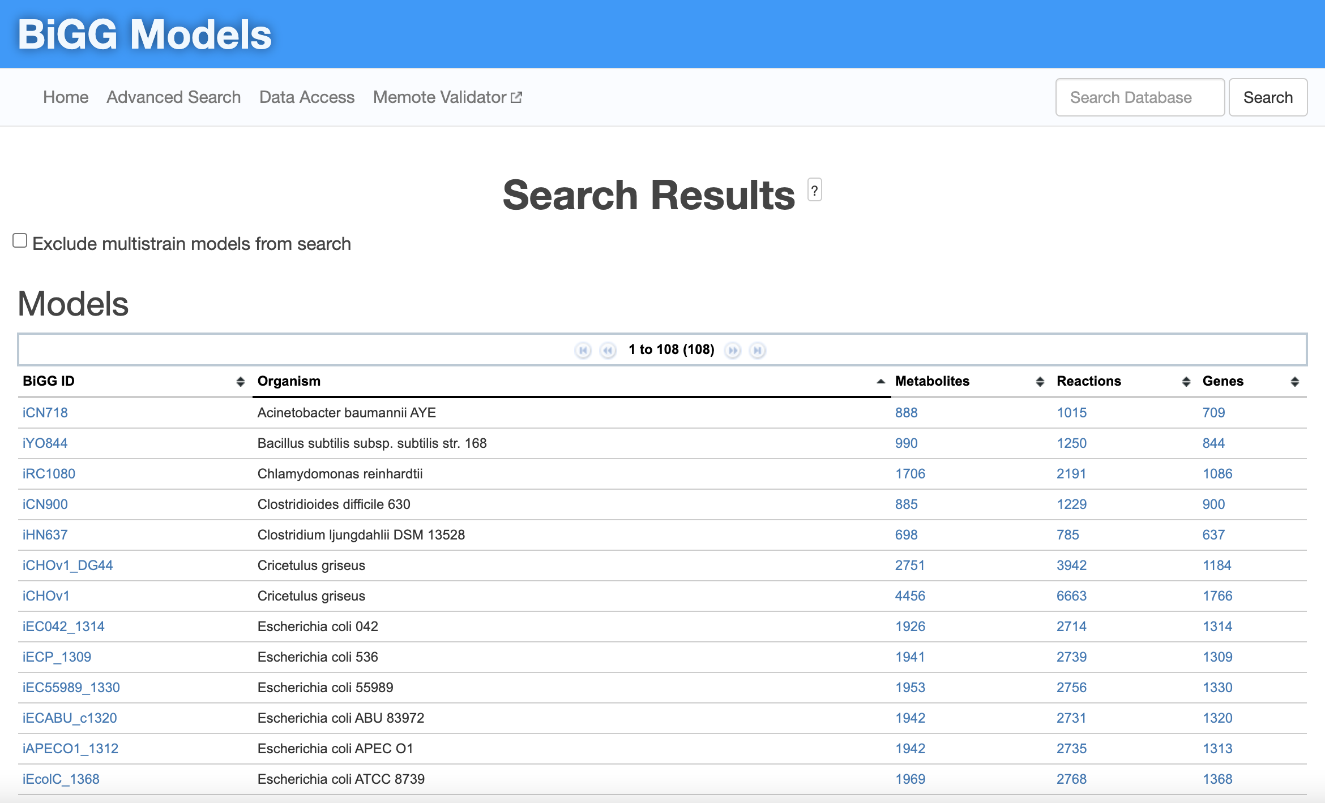
The BiGG database
Biochemical, Genetic, and Genomic database
108 FBA models, 48 single strain models, 30 species
Includes human, mouse, yeast, parasites, quite a few species of bacteria
58 E. coli models!! (more than half of the models in the database)
There are lots more FBA models elsewhere (e.g. with publications), but...
...the models in BiGG follow sensible rules for naming reactions and metabolites
They have an API for grabbing data!
http://bigg.ucsd.edu/models

Slide 9
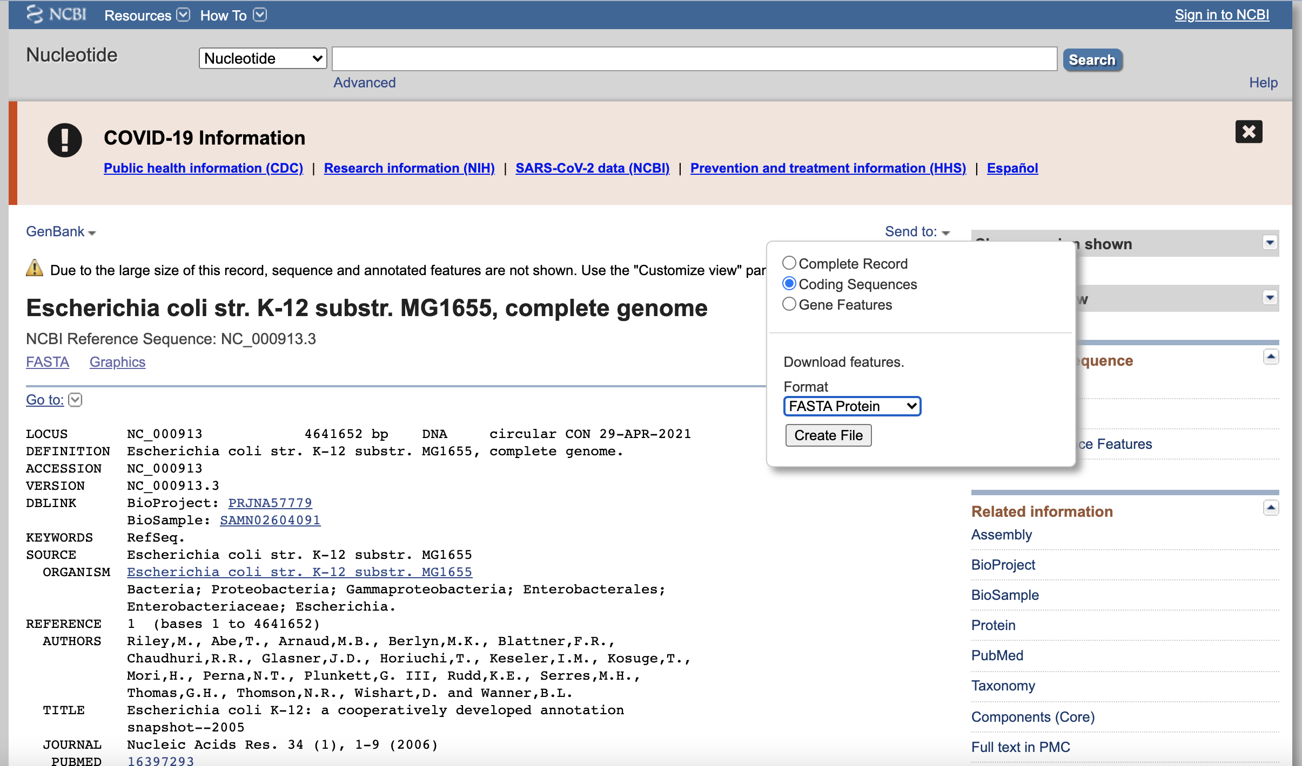
Finding the "known" protein sequences
The BiGG model page should have a link to the genome sequence for the "known" species on NCBI
Download the coding sequences in FASTA Protein format, making sure to give the file a sensible name (the default is "sequence")
Some of you will be using the E. coli K-12 MG1655 FBA model (called iAF1260), and you should use the link on the right to get the protein sequences
The others are using the S. aureus N315 FBA model (called iSB619), and you should use this link to get your protein sequences: https://www.ncbi.nlm.nih.gov/nuccore/NC_002745.2
https://www.ncbi.nlm.nih.gov/nuccore/NC_000913.3

Slide 10
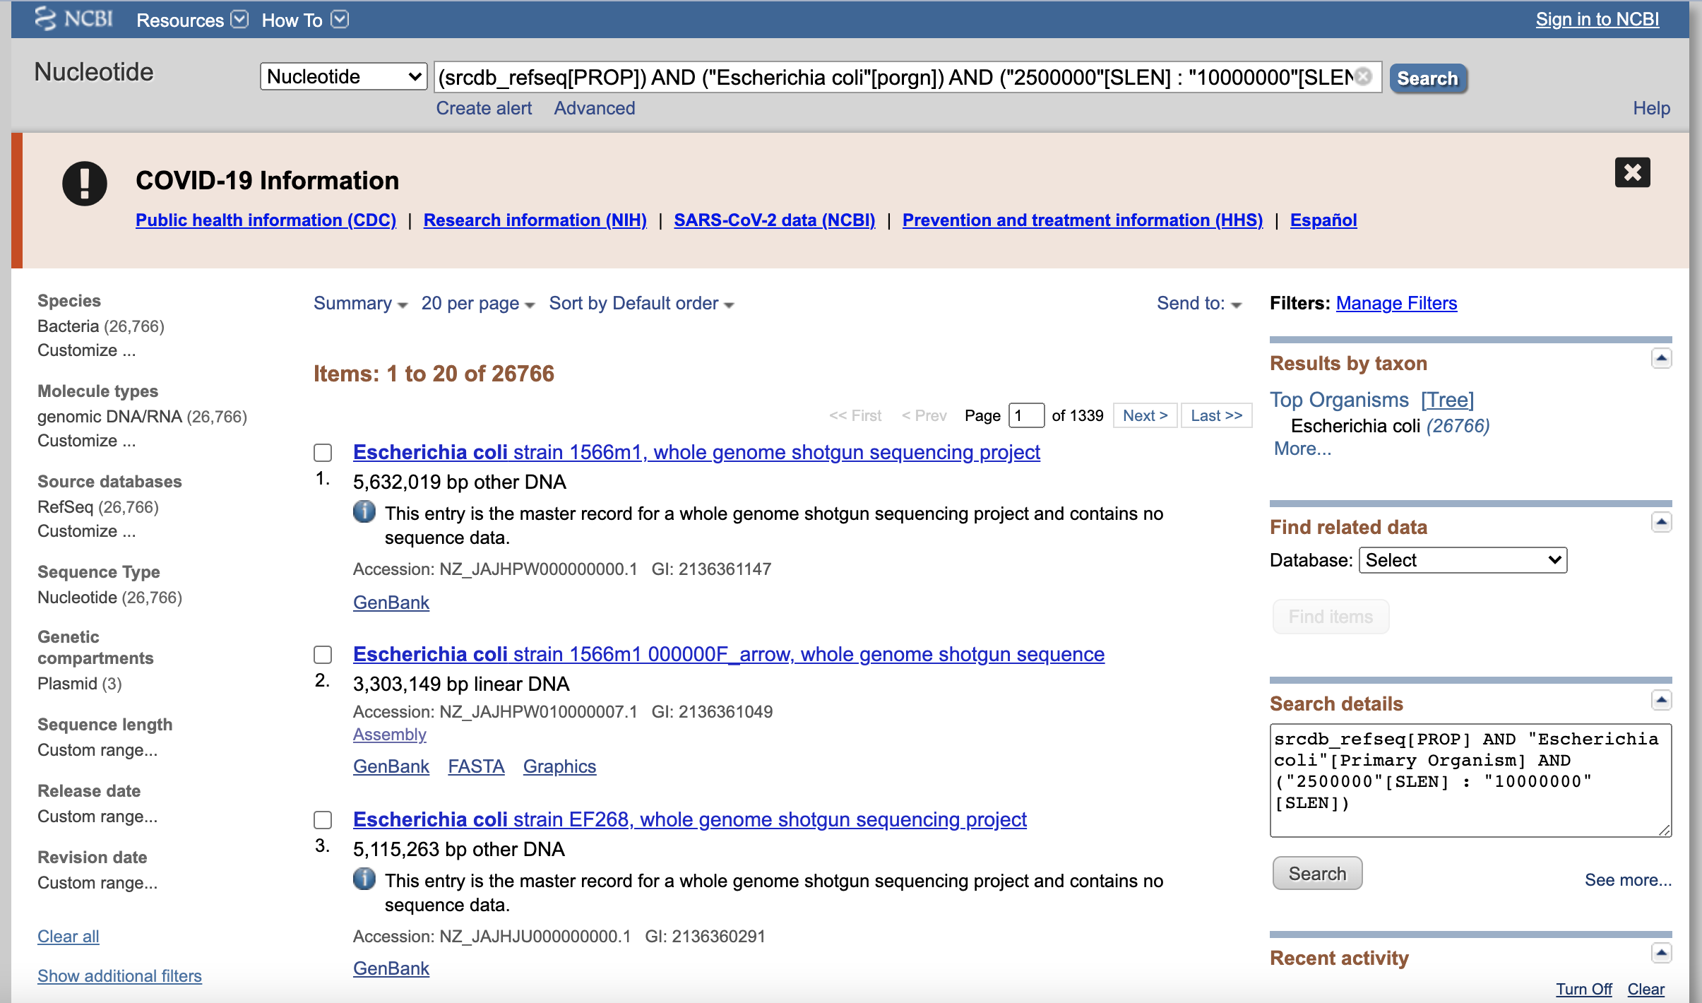
Finding the "unknown" protein sequences
You'll need to pick a closely related species or another strain of the same species as your "known" genome/model
The best place to find these in the NCBI nucleotide database using the filtering options or advanced search to limit it to the right species and RefSeq genomes that are "high quality".
https://www.ncbi.nlm.nih.gov/nuccore
Make sure to ignore plasmids. You can do this with the advanced search by giving a sequence length that is in a similar range to your "known" genome, e.g. 2,500,000 - 10,000,000 for E. coli
Also watch out for the records that say "This entry is the master record... and contains no sequence data."
I used the advanced search: (srcdb_refseq[PROP]) AND ("Escherichia coli"[porgn]) AND ("2500000"[SLEN] : "10000000"[SLEN])
https://www.ncbi.nlm.nih.gov/nuccore?term=%28srcdb_refseq%5BPROP%5D%29%20AND%20%28%22Escherichia%20coli%22%5Bporgn%5D%29%20AND%20%28%222500000%22%5BSLEN%5D%20%3A%20%2210000000%22%5BSLEN%5D%29&cmd=DetailsSearch

Slide 11
Reciprocal BLAST hits (RBH)
BLAST is a sequence similarity search method that's widely used
Usually you'll search one or more sequences against a database of sequences to find the most similar matches (hits)
You measure similarity by:
% identity (prop. of matching letters in the alignment)
% coverage (prop. of your query sequence covered by the alignment)
E value (probability that the match in the database occurred at random)
A reciprocal BLAST hit BLASTs the hit back against all of the original sequences to ensure the original sequence is found again

Slide 12
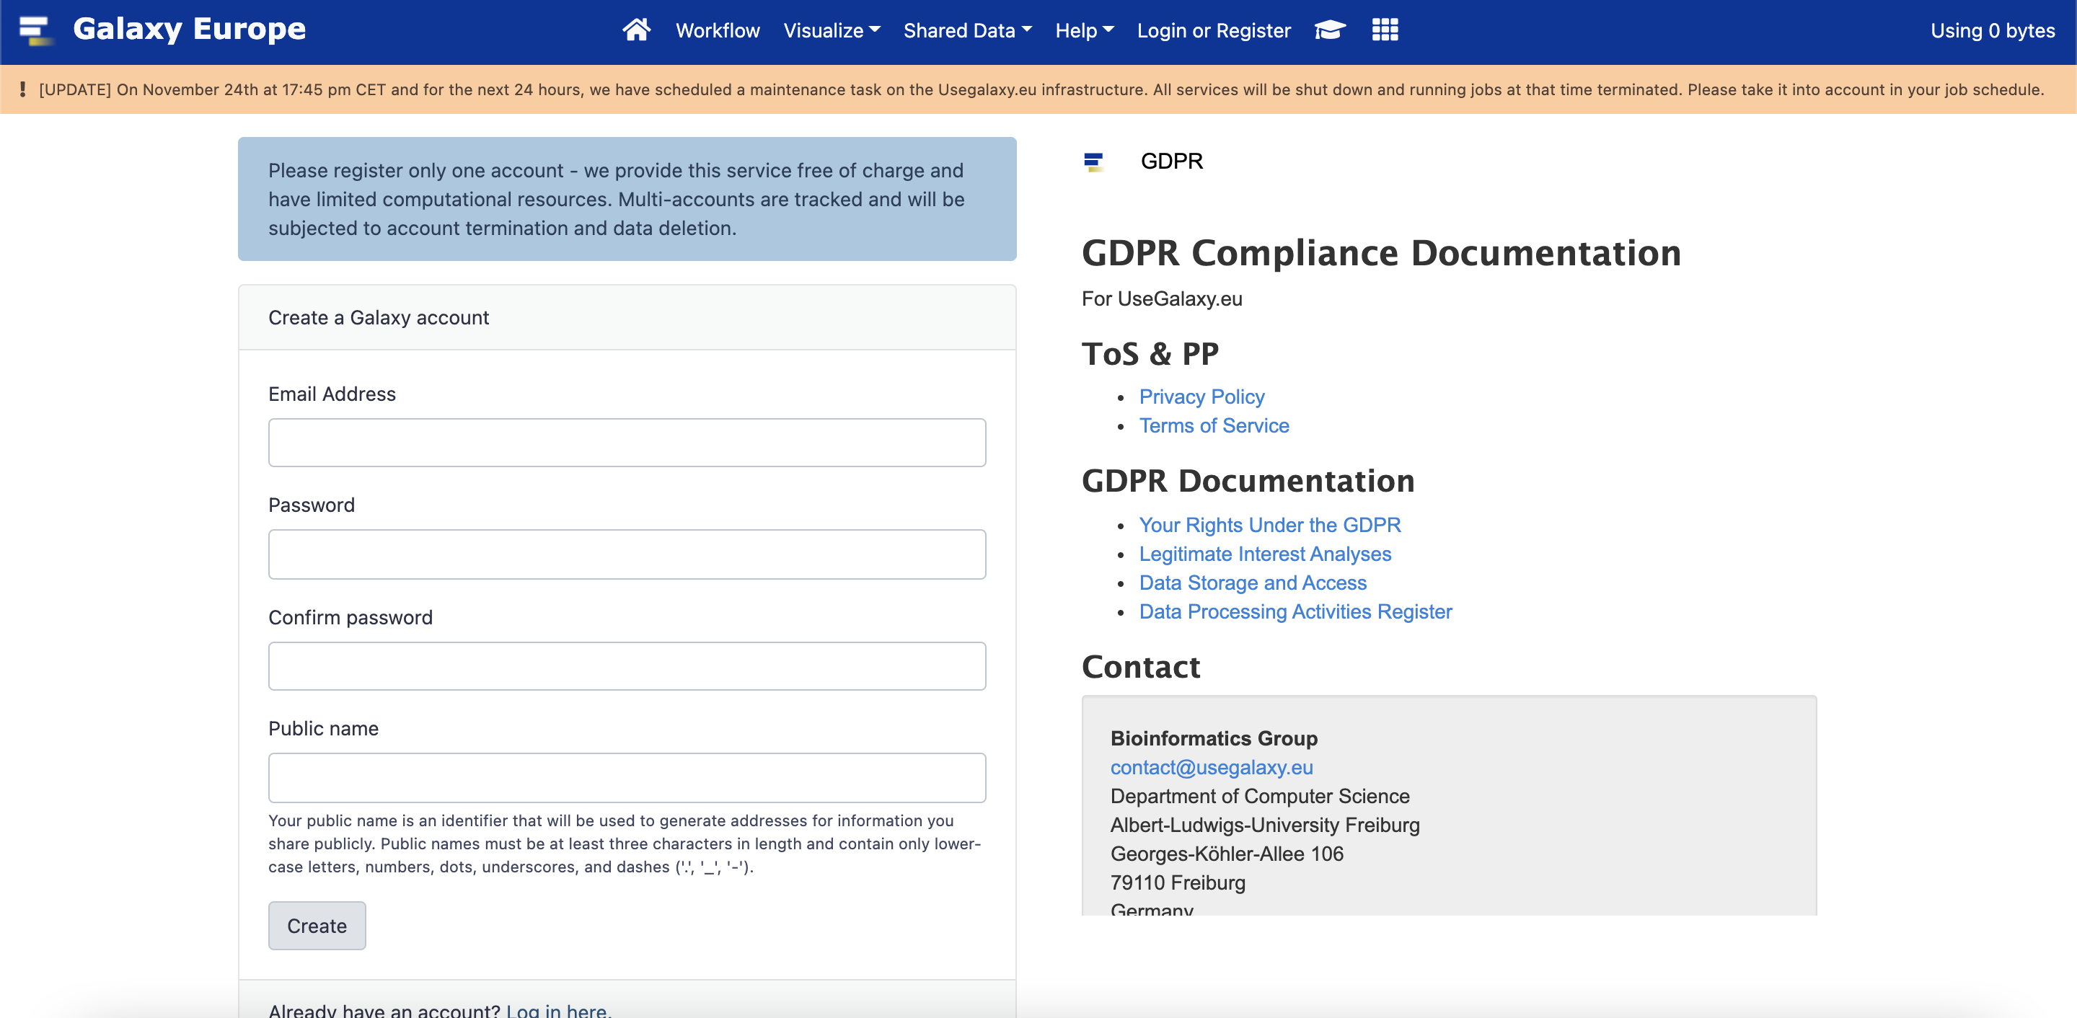
Galaxy (usegalaxy.eu)
Galaxy is a web tool for running bits of bioinformatics software, like BLAST, that would normally be on the command line
You can sign up for a free account here: https://usegalaxy.eu/login
Galaxy has a reciprocal BLAST function that we can use with our two sets of protein sequences to find matches

Slide 13
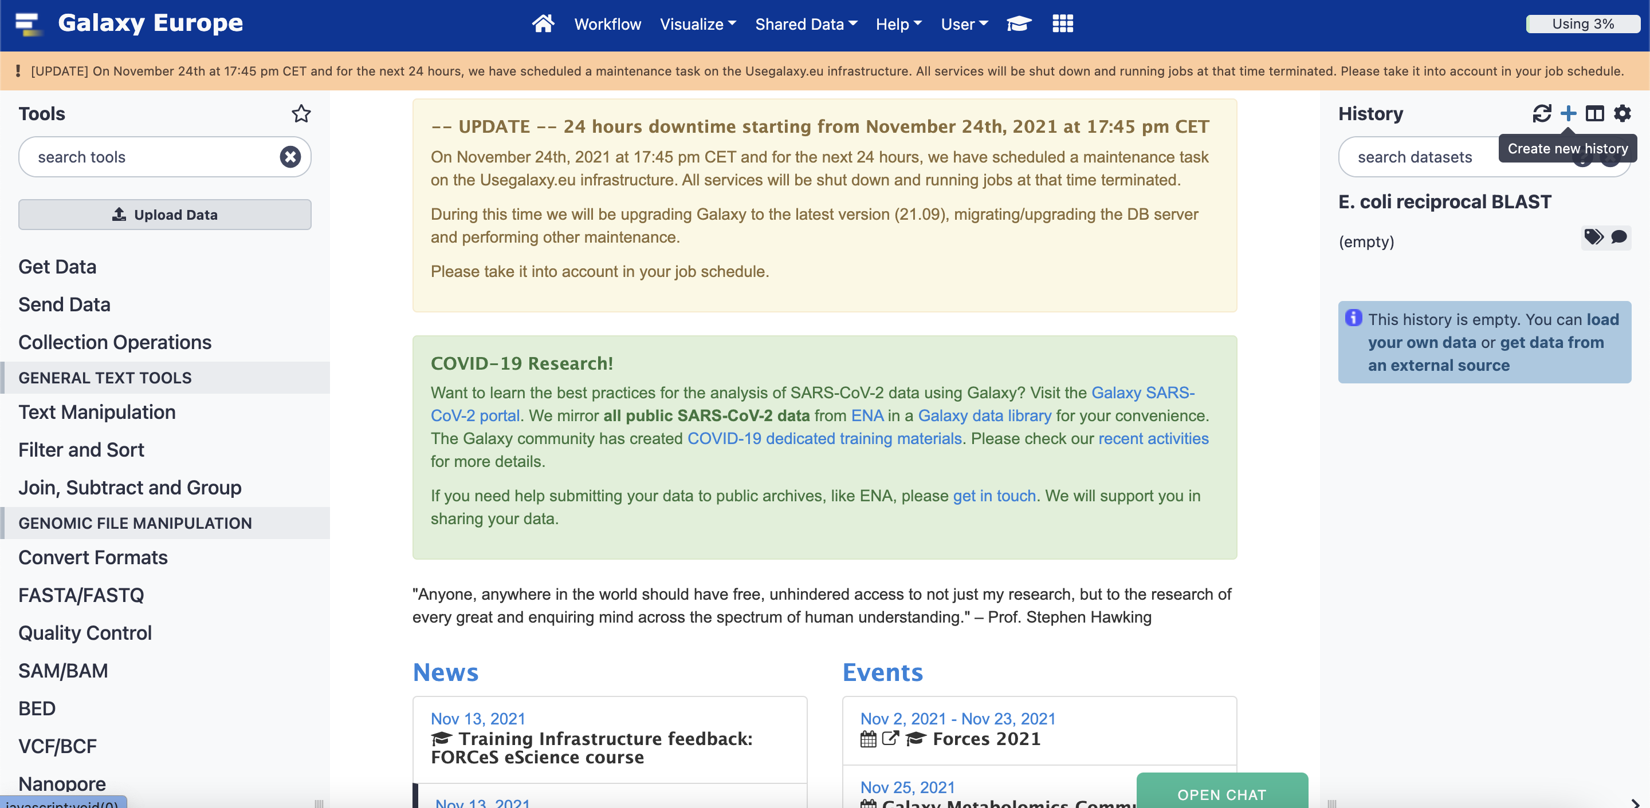
Create a new history

Slide 14
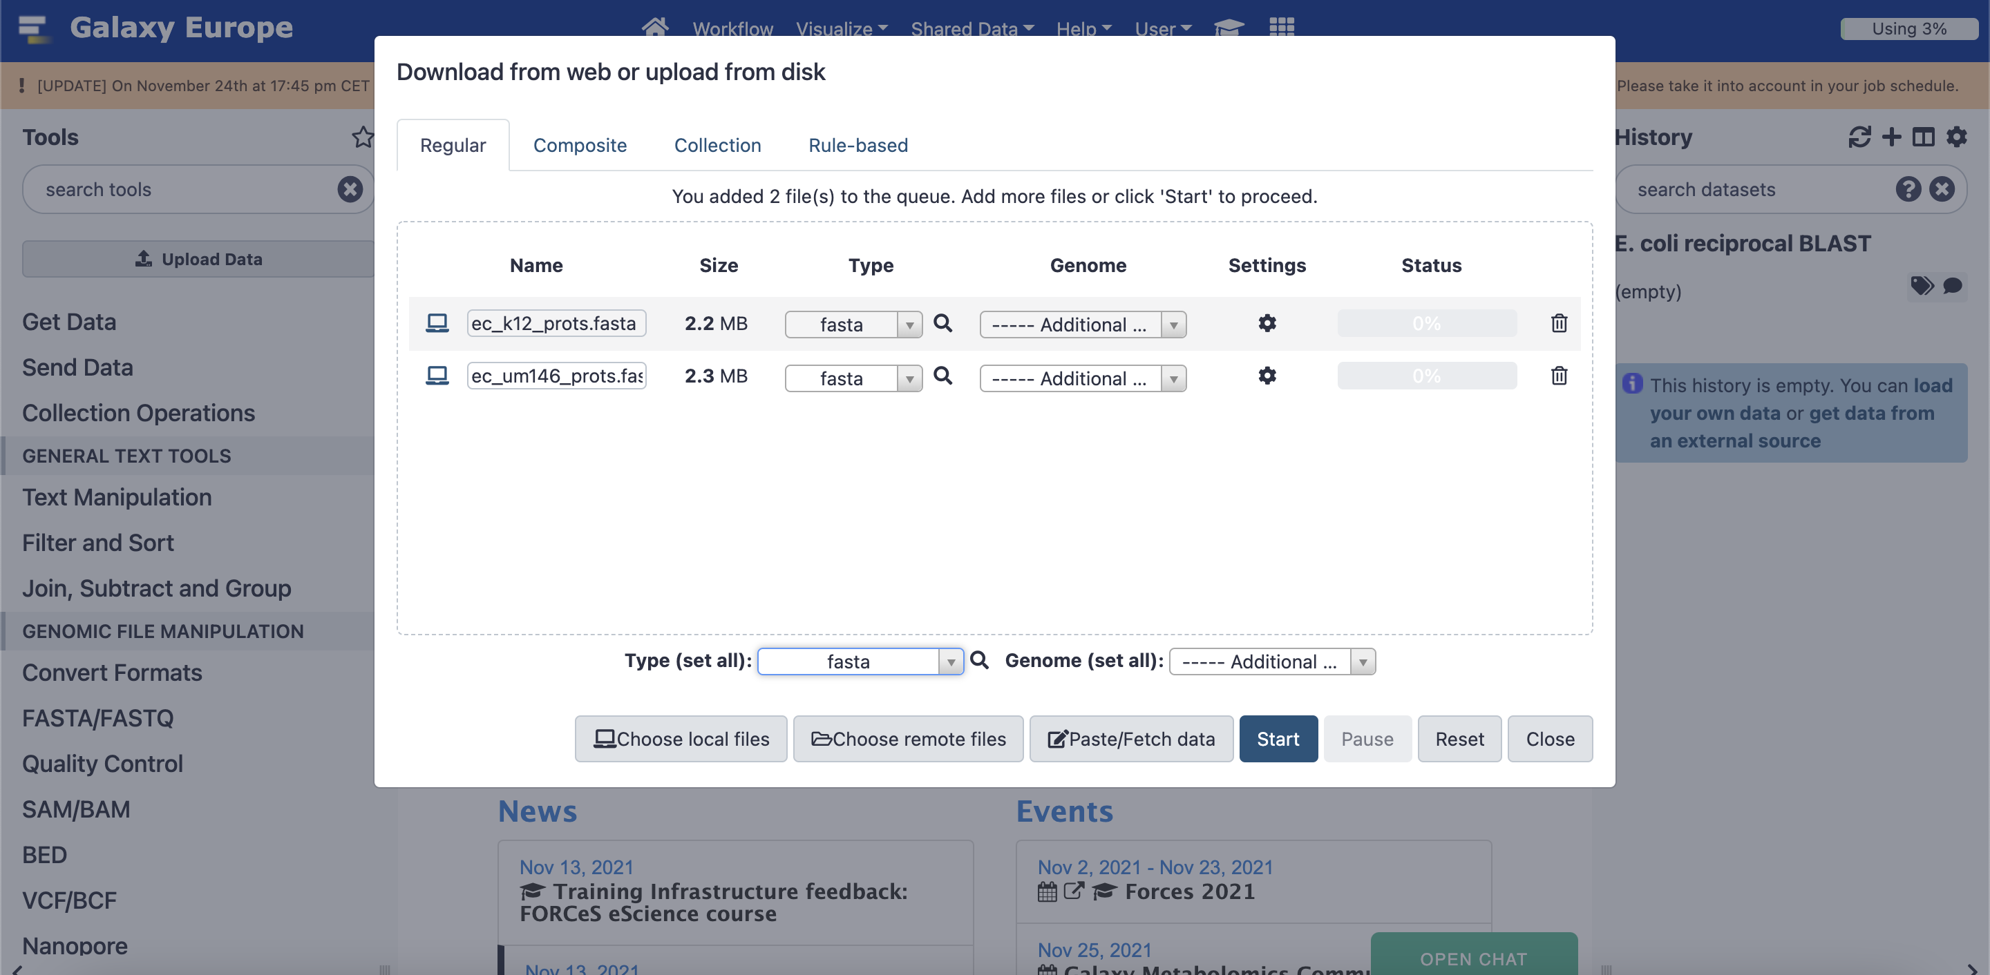
Click on "load your own data", select your two fasta files, and set type to fasta, click "Start"

Slide 15
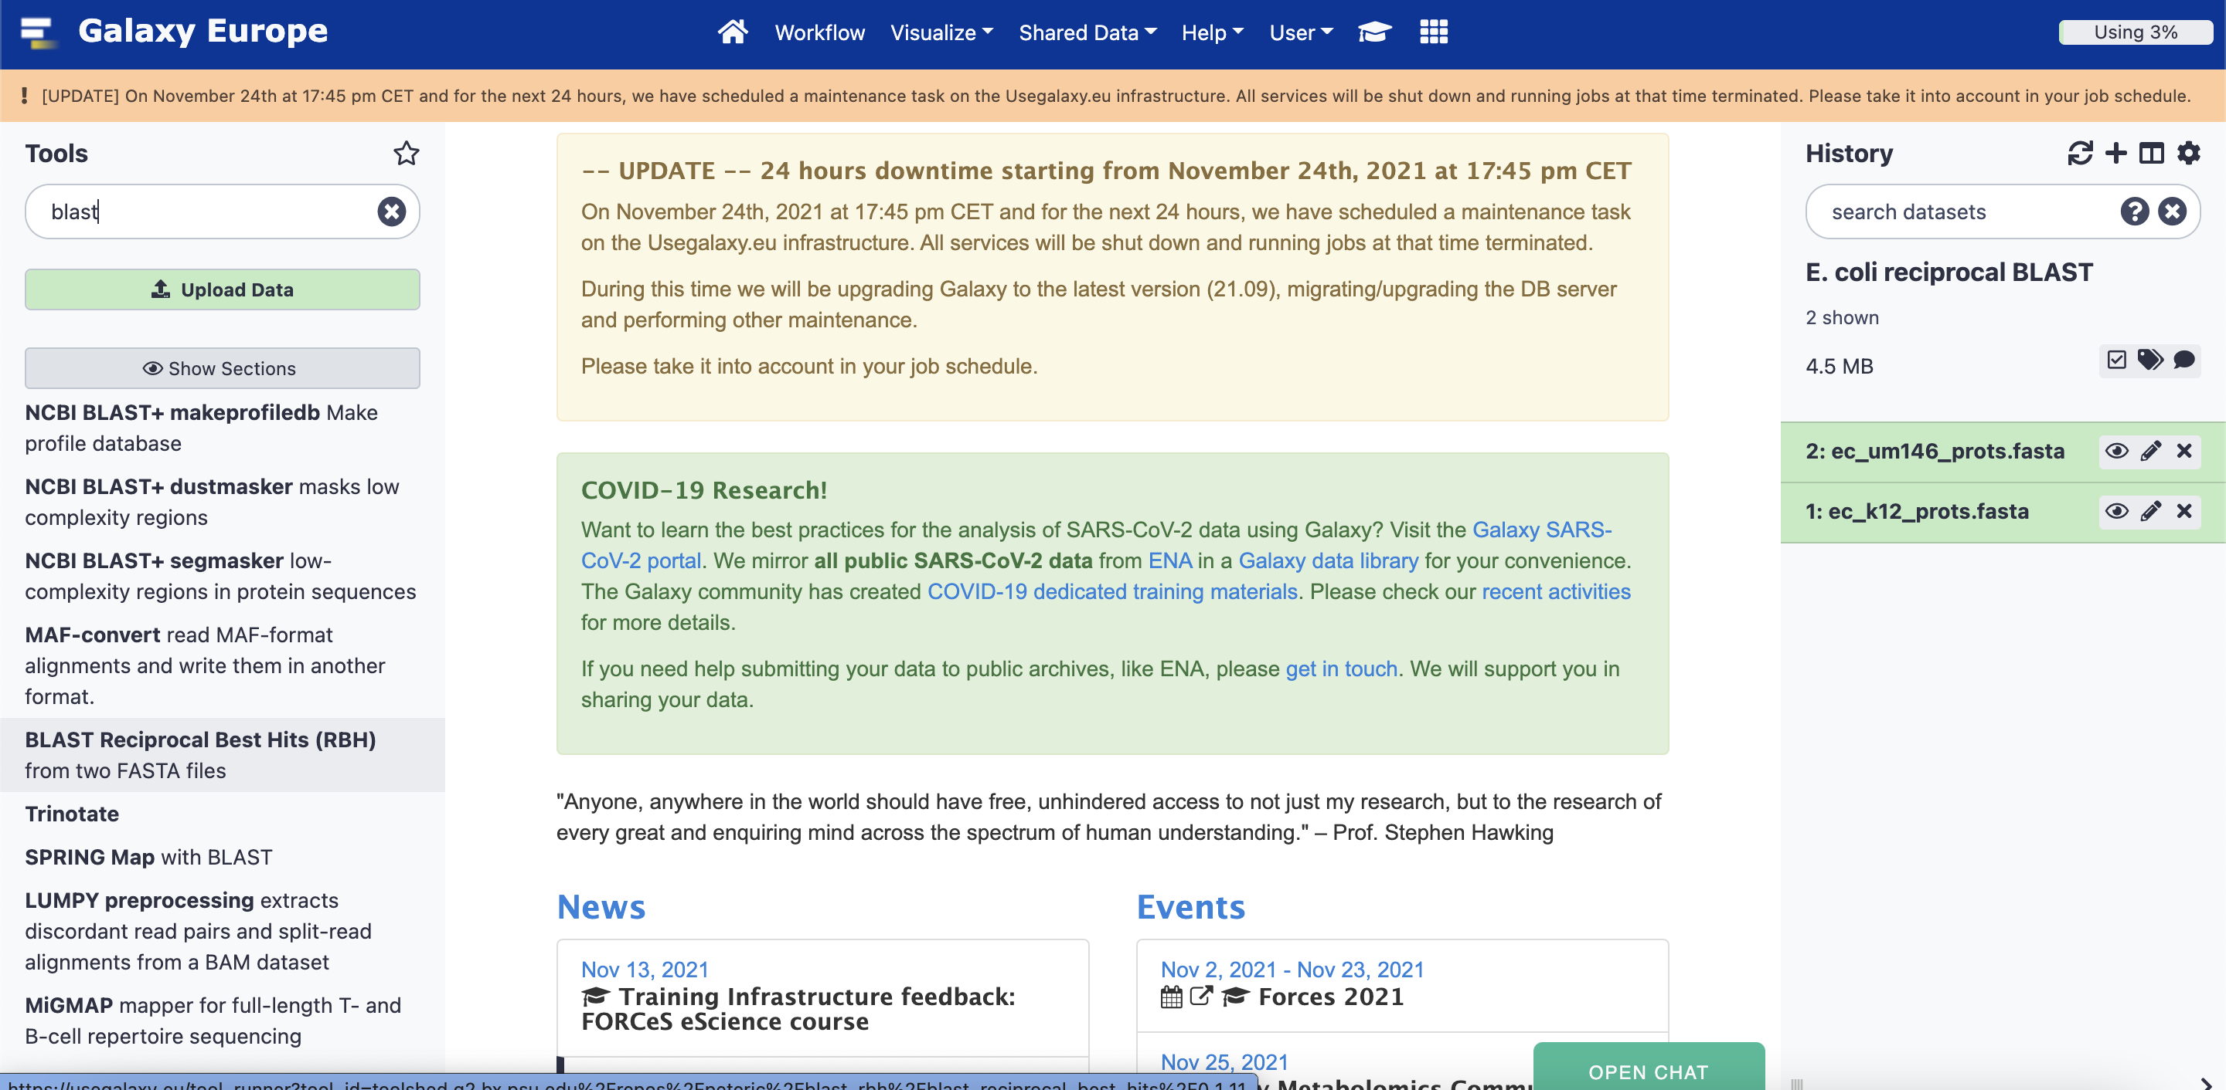
Search the Tools for "blast" and select "BLAST Reciprocal Best Hits (RBH)"

Slide 16
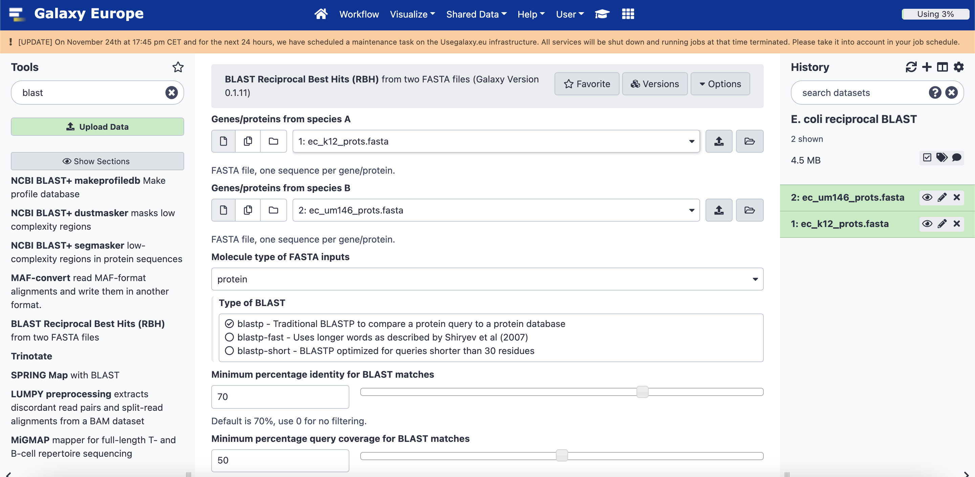
Select your two fasta files, change the "Molecule type" to "protein", and "blastp", then click "Execute"

Slide 17
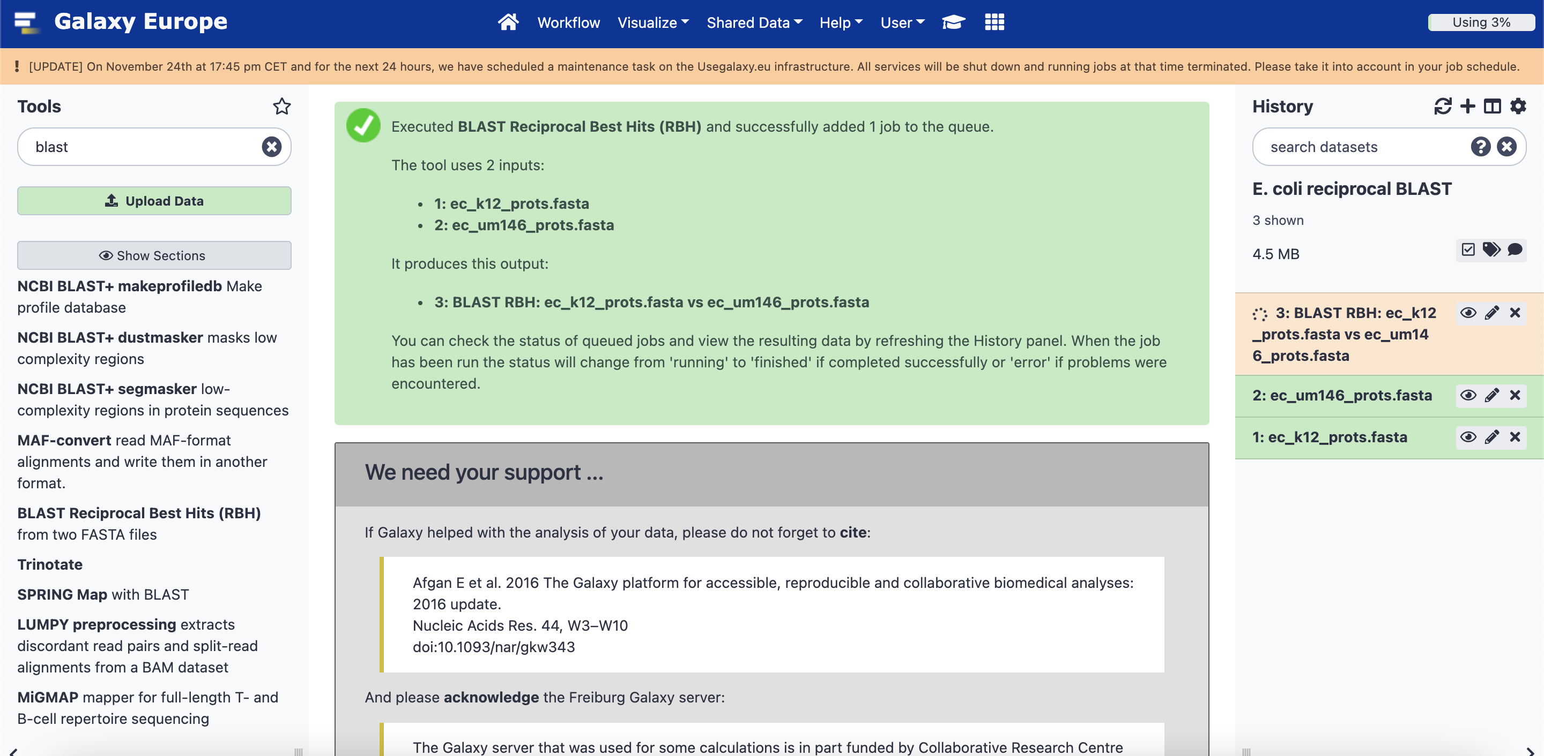
Wait for the reciprocal BLAST task to turn from orange to green when it's complete

Slide 18
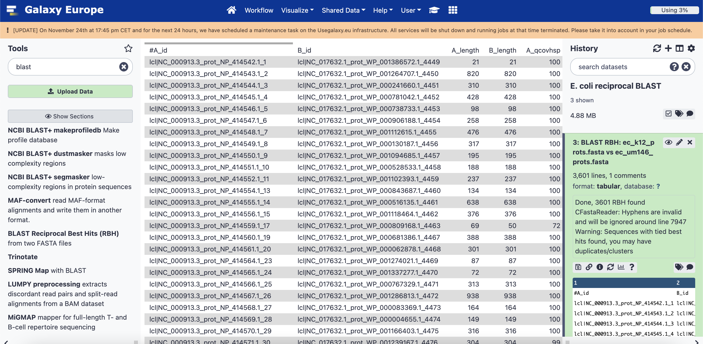
Have a look at your results, then click the little disk icon to download and save the file

Slide 19
Things to think about
Check the number of sequences in both your "known" fasta file, and the "unknown" fasta file. You can find this by clicking the fasta filename in the history bar at the side to expand it.
Check the number of lines in your BLAST results file the same way. The number of lines is the number of hits the "known" sequences had against the "unknown" ones.
What proportion have hits?
Do the hits have high percentage identity and coverage?
What would have happened if we'd changed the default settings for the identity and coverage before running the reciprocal BLAST?
(the defaults (>70% identity, >50% coverage) are a good rule of thumb)

Slide 20
The perennial bioinformatics problem: IDs!
Our fasta sequences look like this:
>lcl|NC_000913.3_prot_NP_414579.4_37 [gene=caiC] [locus_tag=b0037] ...
MDIIGGQHLRQMWDDLADVYGHKTALICESSGGVVNRYSYLELNQEINRTANLFYTLGIRKGDKVALHLD
NCPEFIFCWFGLAKIGAIMVPINARLLCEESAWILQNSQACLLVTSAQFYPMYQQIQQEDATQLRHICLT
DVALPADDGVSSFTQLKNQQPATLCYAPPLSTDDTAEILFTSGTTSRPKGVVITHYNLRFAGYYSAWQCA
LRDDDVYLTVMPAFHIDCQCTAAMAAFSAGATFVLVEKYSARAFWGQVQKYRATVTECIPMMIRTLMVQP
PSANDQQHRLREVMFYLNLSEQEKDAFCERFGVRLLTSYGMTETIVGIIGDRPGDKRRWPSIGRVGFCYE
AEIRDDHNRPLPAGEIGEICIKGIPGKTIFKEYFLNPQATAKVLEADGWLHTGDTGYRDEEDFFYFVDRR
CNMIKRGGENVSCVELENIIAAHPKIQDIVVVGIKDSIRDEAIKAFVVLNEGETLSEEEFFRFCEQNMAK
FKVPSYLEIRKDLPRNCSGKIIRKNLK
But the gene reaction rules in the model look like this:
{"id": "CRNDCAL2",
"name": "D-Carnitine-CoA Ligase",
"metabolites":
{
"adp_c": 1.0,
"atp_c": -1.0,
"coa_c": -1.0,
"crnDcoa_c": 1.0,
"crn__D_c": -1.0,
"pi_c": 1.0
},
"lower_bound": 0.0,
"upper_bound": 999999.0,
"gene_reaction_rule": "b0037",
"subsystem": "Oxidative Phosphorylation"},

Slide 21
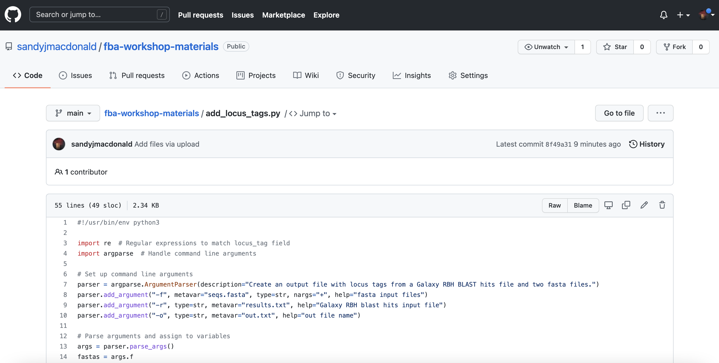
Python to the rescue!
My add_locus_tags.py script
I've written a Python script that takes the two fasta files, the blast results file, and the name you want to call your output file, and it creates an output file with the matching locus tags on each line
You can find it here: https://github.com/sandyjmacdonald/fba-workshop-materials/blob/main/add_locus_tags.py
Put the Python script in the same directory as your two fasta files and blast results file and then run it by typing this in the terminal:
python3 add_locus_tags.py -f known.fasta unknown.fasta -r blast_results.tabular -o results_locus_tags.txt

Slide 22
Filtering your model
With our list of locus tags that match from our "known" genome against our "unknown" genome, we can now go through the reactions in the "known" model and check whether the genes in the gene reaction rule have matches
What's the best way to do this filtering? Python again!
COBRApy is a Python library for working with FBA models: https://github.com/opencobra/cobrapy
We can use it to check our list of locus tags against each reaction, keep only the matching ones, and then swap the locus tags, replacing the "known" locus tags with the "unknown" (now also known!) ones

Slide 23
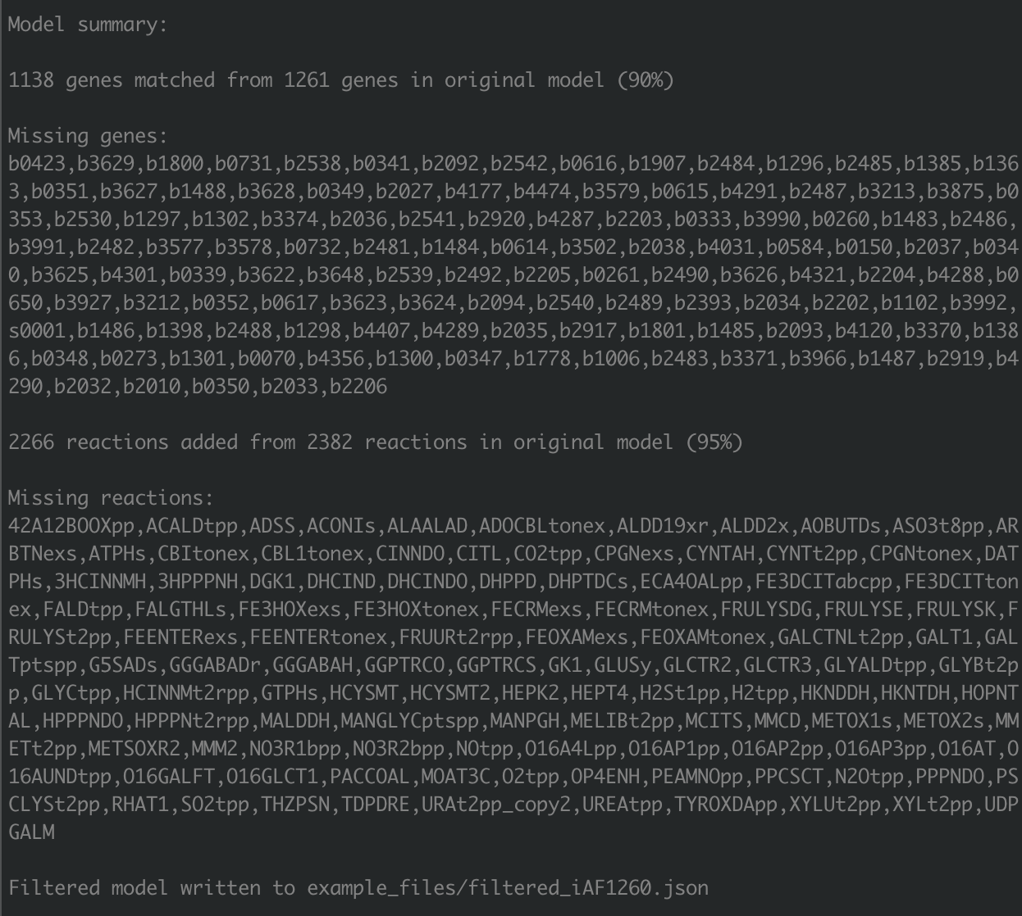
Python to the rescue again!
My filter_fba_model.py script
To make the process a bit easier, I've made a Python script that uses COBRApy to filter an FBA model in json format if you give it a text file. like the one we created, that maps the known locus tags to the unknown ones
You can find it in the same GitHub repository: https://github.com/sandyjmacdonald/fba-workshop-materials/blob/main/filter_fba_model.py
Run it by typing, for example:
python3 filter_fba_model.py -l locus_tags_map.txt -m model.json

Slide 24
You're only just at the start!
There's still a lot left to do!
Your model will likely have a lot of gaps in it (and errors)
Gap-filling, which COBRApy can do, will give you a working model but ideally you need to find candidate genes for those gap-filled reactions
Try re-running the BLAST with lower cutoffs to see if any of these missing genes turn up. Promiscuous enzymes? Side reactions?
Are all the assignments from our BLAST correct?
Check if the genes in the "unknown" genome have been characterised.
Do any exchange reactions need to be added to make pathways work?
What should the biomass reaction be?

Slide 25
Give it a go...
Run through this process and pick your own "unknown" strain or species
I'd recommend starting with another strain of the same species and if your new model is too good then try a different species
Does your model work at all?
If not, then can you try gap-filling?

Slide 26
Key things
What "unknown" organism did you pick, and why?
What proportion of the "known" genes had hits to "unknown" genes?
Pick another set of BLAST cutoffs and see how this changes
What proportion of genes and reactions are retained in your filtered model compared to the original model?
Can you think of reasons why genes could be missing?

Slide 27
Questions? Queries?
Pop me an email with any questions or queries: s.macdonald@york.ac.uk

